Slide 1


Masterclass Series Time-Dependent Density-Functional Theory (TDDFT)
Robert Michael “Boppo” Jones
Attosecond Quantum Physics Laboratory, Department of Physics – King’s College London
www.attokings.com

Slide 2
What’s the agenda, Brenda? What’s the plan, Stan?
Introduction
The many-body challenge
Why (TD)DFT?
Ground state foundations
Addressing the many-body problem
From wavefunction to density
Kohn-Sham Theory
Assumptions and approximations
Born-Oppenheimer approximation
Psuedopotentials
Exchange-Correlation
Basis sets
SCF convergence

Slide 3
What’s the agenda, Brenda? What’s the plan, Stan?
Time dependence
Runge-Gross theorem
Propagation methods
δ-kick method
Setting optical fields
The Casida equations
What can be calculated?
Static (ground state)
Time-dependent
Worked examples
Finite and periodic systems
Gases, molecules, solids

Slide 4

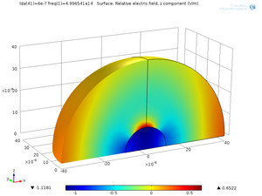
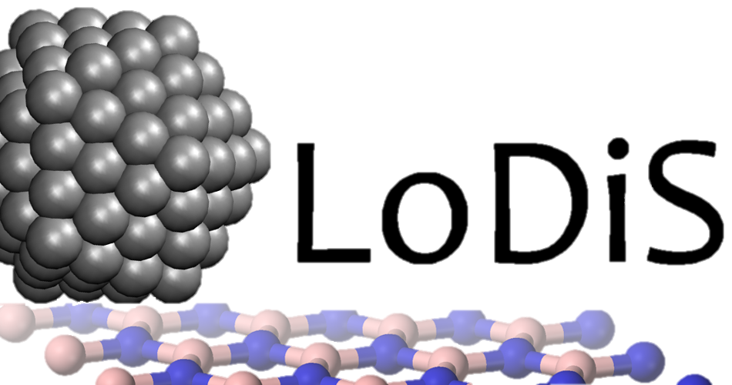
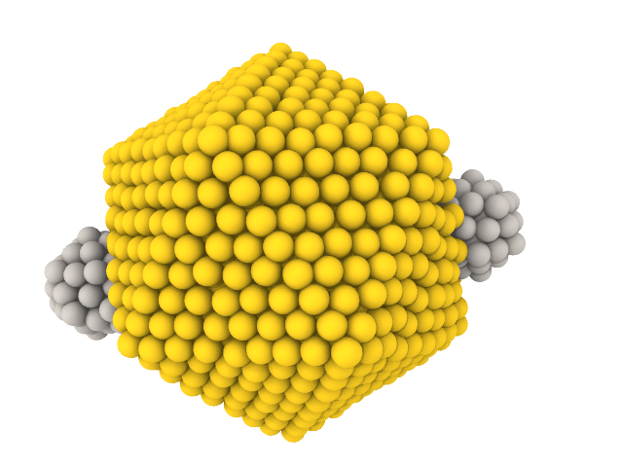
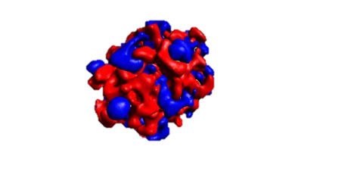

The multiscale modelling ladder
Log Size scale (nm)
6
. . .
-1
1
9
Determine properties at the atomistic scale and compute stability at various T.
Just ask them
Log Time Scale (s)
Continuum
-9
-12
-15
Classical
-18
Quantum
. . .
27
0
1
2
3
4
5
Log Number of atoms

Slide 5

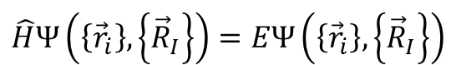
Introduction – The many-body challenge
$$\hat{H}Ψ\left(\left\{{\vec{r}}_{i}\right\},\left\{{\vec{R}}_{I}\right\}\right)=EΨ\left(\left\{{\vec{r}}_{i}\right\},\left\{{\vec{R}}_{I}\right\}\right)$$
All Ab Initio techniques must start with a reformulation of the molecular Hamiltonian.
Many-body problem is insoluble!
It gets worse! Approximate SE methods scale exponentially with number of particles.
Coarser approximations necessary.

Slide 6
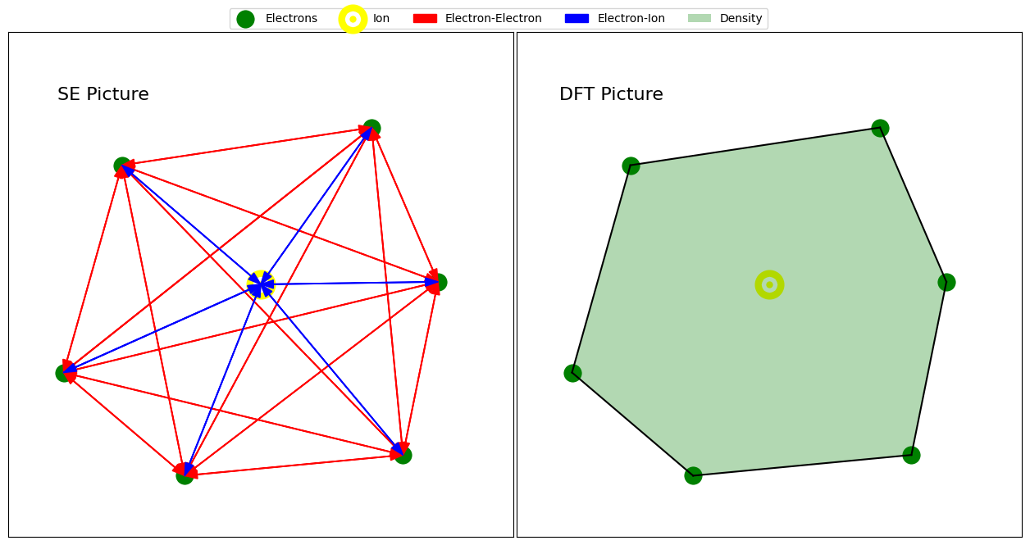
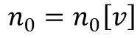
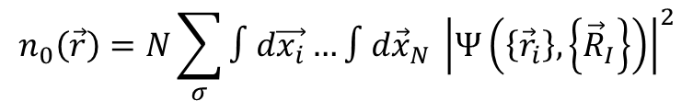
Ground state – many-body problem
Solution – Recast the many-body interacting problem with one of a non-interacting ansatz in an exact way.
This is typically done in the language of the electron density.
$$n_{0}\left(\vec{r}\right)=N\sum_{σ}{∫d\vec{x_{i}}…∫d{\vec{x}}_{N} {\left|Ψ\left(\left\{{\vec{r}}_{i}\right\},\left\{{\vec{R}}_{I}\right\}\right)\right|}^{2}}$$
$$n_{0}=n_{0}\left[v\right]$$
First Hohenberg-Kohn Theorem
To within an additive constant, the external potential uniquely determines the ground state.
Proof ad absurdum.

Slide 7

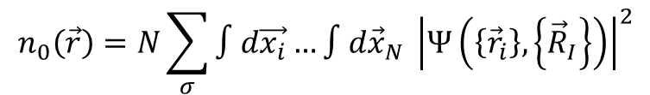
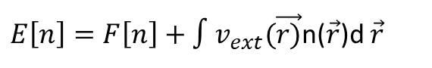
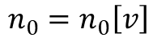
Ground state – wavefunction to density
$$n_{0}\left(\vec{r}\right)=N\sum_{σ}{∫d\vec{x_{i}}…∫d{\vec{x}}_{N} {\left|Ψ\left(\left\{{\vec{r}}_{i}\right\},\left\{{\vec{R}}_{I}\right\}\right)\right|}^{2}}$$
$$n_{0}=n_{0}\left[v\right]$$
Second Hohenberg-Kohn Theorem
There exists a universal functional such that the energy is minimised at the true ground-state density.
Proof variational principle
$E\left[n\right]=F\left[n\right]+∫v_{ext}(\vec{r)}$n($\vec{r}$)d $\vec{r}$
Therefore
All ground- and excited-state properties of a given N-electron system are given uniquely by the ground state particle density
The wavefunction, 3N variables, is out
The density, 3 variables, is in
What’s the catch?

Slide 8
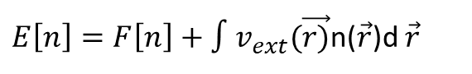
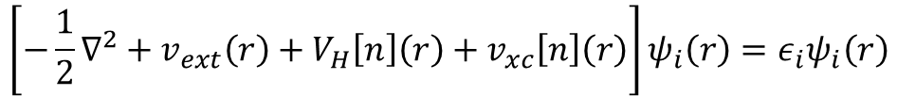
Ground state – Kohn-Sham theory
$E\left[n\right]=F\left[n\right]+∫v_{ext}(\vec{r)}$n($\vec{r}$)d $\vec{r}$
$$F[n]=T_{s}\left[n\right]+\frac{1}{2}∫dr∫dr^{′}n\left(r\right)w\left(r,r^{′}\right)n\left(r^{′}\right)+E_{xc}[n]$$
$$\left[−\frac{1}{2}∇^{2}+v_{ext}\left(r\right)+V_{H}\left[n\right]\left(r\right)+v_{xc}\left[n\right]\left(r\right)\right]ψ_{i}\left(r\right)=ε_{i}ψ_{i}\left(r\right)$$
What have we done?
Created a closed self-consistent form to extract the eigenspectrum of the problem
Introduced two new quantities
Hartee term and exchange-correlation term
The problem in principle becomes a boundary value problem solved by Euler equations
Note that Kohn-Sham states/”orbitals” are auxiliary quantities and do not represent excitations of the system!

Slide 9
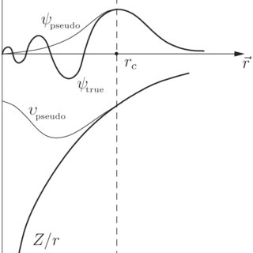
Ground state – Some Approximations
Born-Oppenheimer approximation
Ions are fat and slow!
Decouple time scales
Ions become part of a fixed potential
Pseudopotentials
Highly oscillatory wavefunctions near the core
Merge core electrons with nucleus to form an effective ion
Smooths out 1/r Coulomb interaction
Many flavours and choices depending on need and prescription – consult your doctor (of DFT)
Exchange-correlation potential
Accounts for fermion behaviour of electrons
Exchange – electrons with same spin must occupy different spatial orbits
Correlation – Electrons repel each other beyond simple Coulomb interactions
Local density approximation (LDA)
xc energy at a point in space depends on local density and assumes the system is locally homogeneous
Exchange from Dirac
Correlation from Quantum monte Carlo data
Tends to overbind but is simple
Generalised gradient approximation
Incorporate gradient of density to account for inhomogeneities
Exchange – enhanced LDA with a gradient factor
Correlation – similar gradient corrections
Improved accuracy for geometries

Slide 10
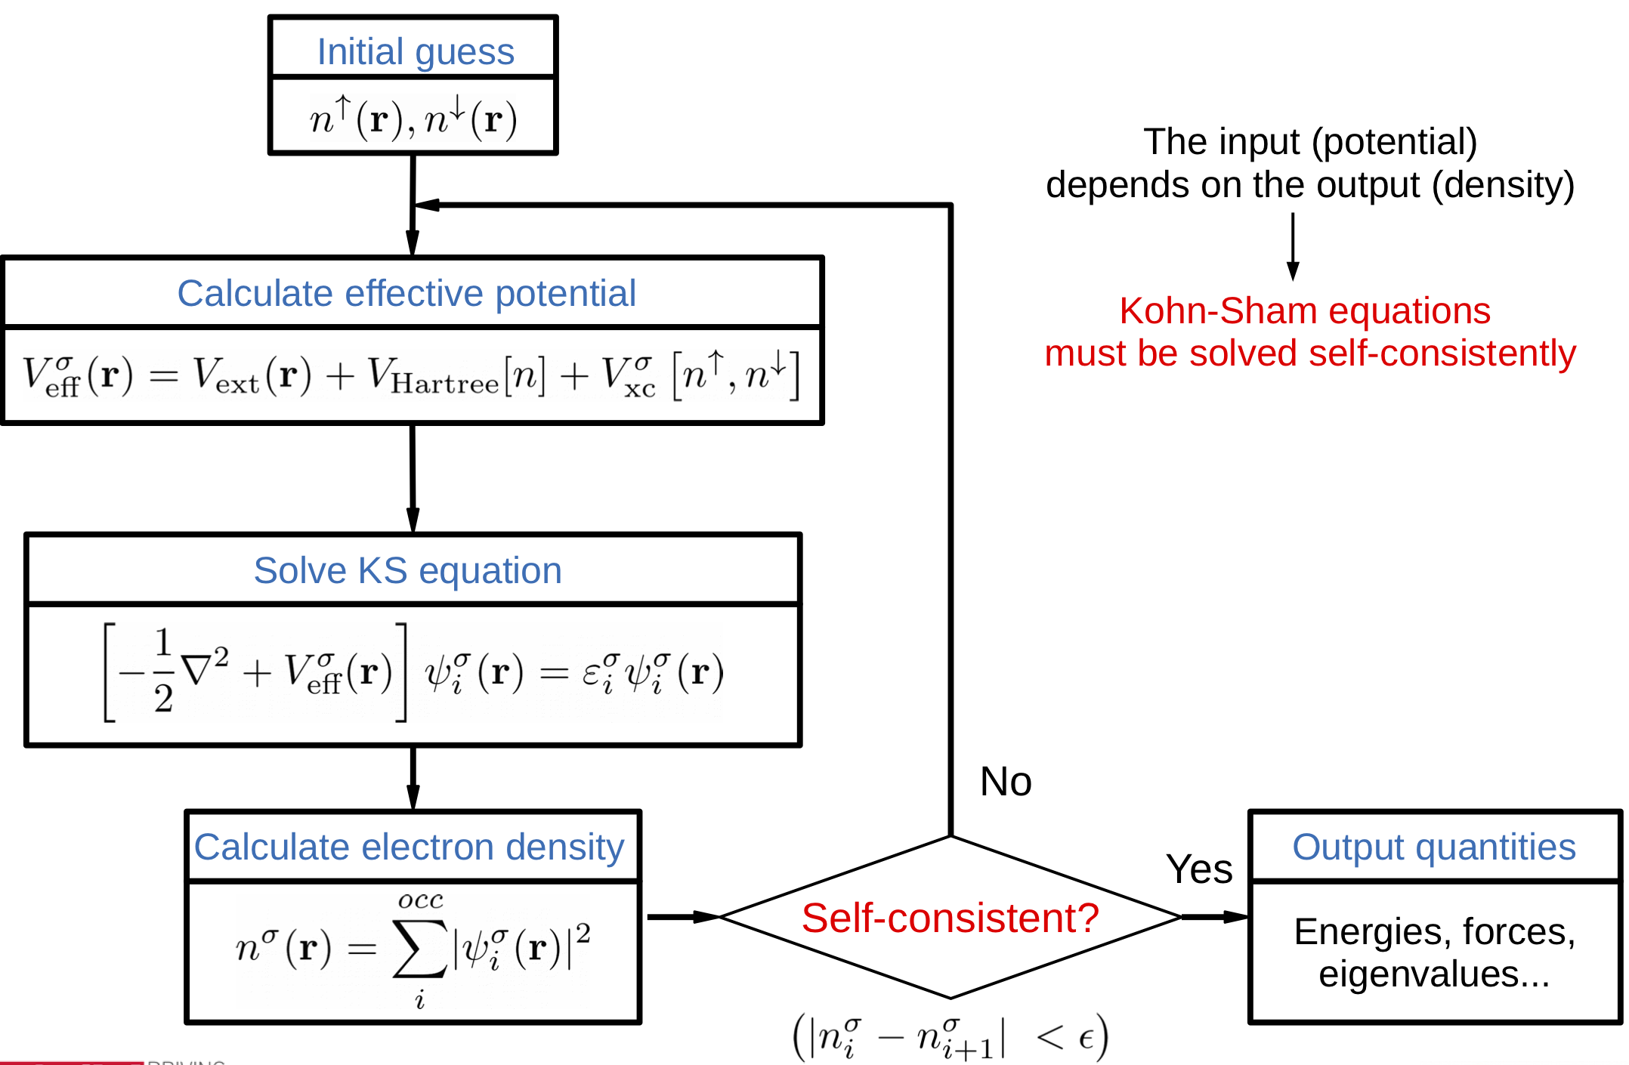
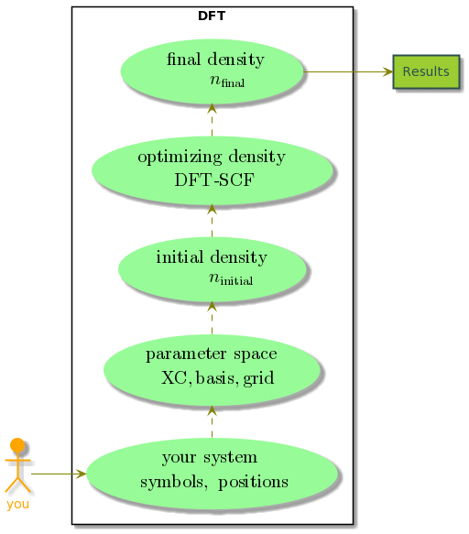
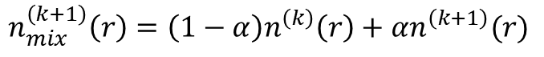
Ground state – SCF Convergence
Self-Consistent Field solves KS equations iteratively until a converged electron density is obtained
Initial guess
Construct effective potential
Solve the KS equations
Compute density
Check convergence
Mix?
Iterate if necessary – Party if not
Mixing can help avoid issues like oscillations or divergence in the cycle
$$n_{mix}^{\left(k+1\right)}\left(r\right)=\left(1−α\right)n^{\left(k\right)}\left(r\right)+αn^{\left(k+1\right)}(r)$$

Slide 11
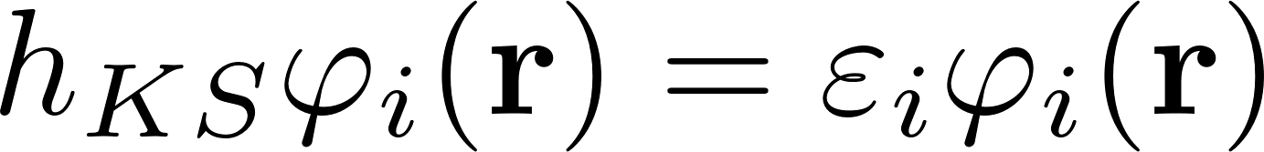
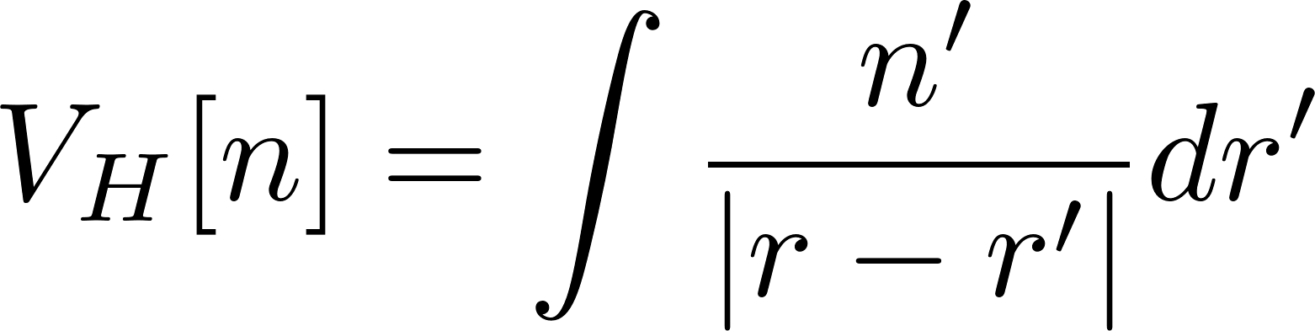
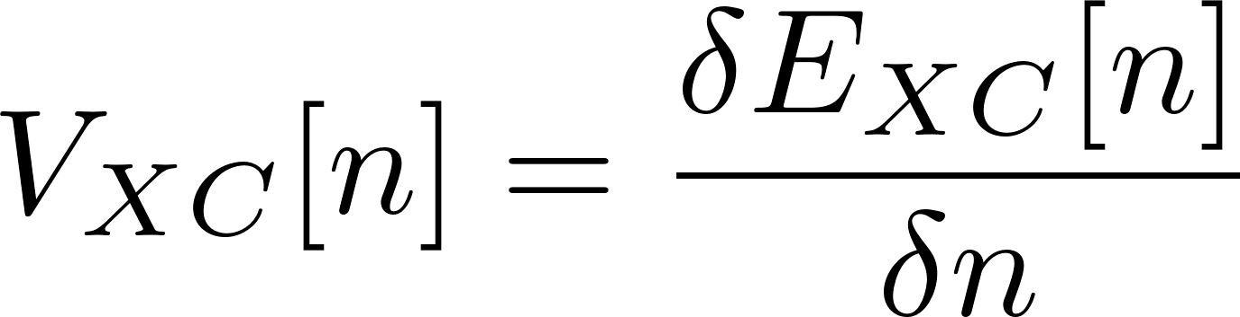
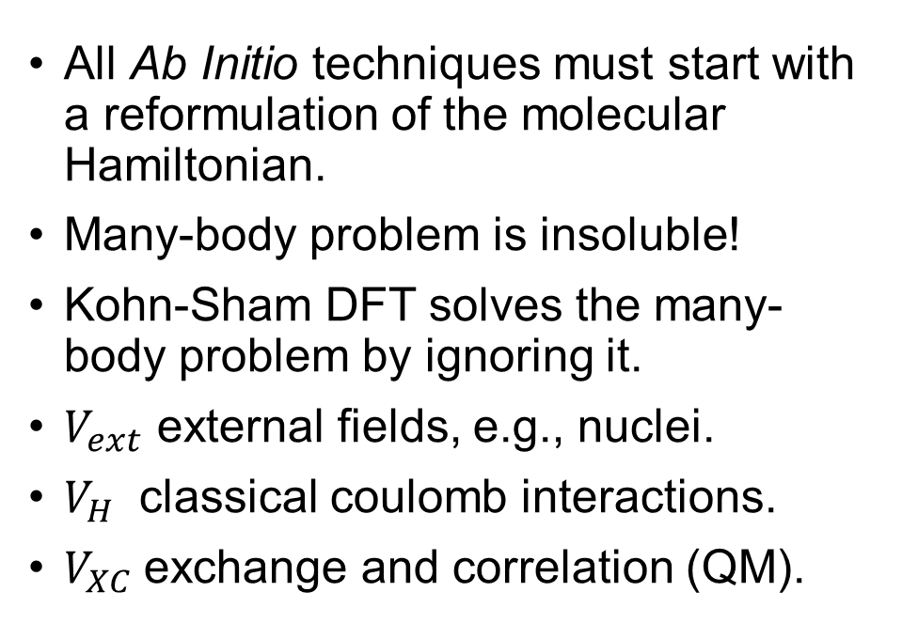
Introduction and ground state - Summary
All Ab Initio techniques must start with a reformulation of the molecular Hamiltonian.
Many-body problem is insoluble!
Kohn-Sham DFT solves the many-body problem by ignoring it.
$V_{ext}$ external fields, e.g., nuclei.
$V_{H}$ classical coulomb interactions.
$V_{XC}$exchange and correlation (QM).

Slide 12
What’s the agenda, Brenda? What’s the plan, Stan?
Introduction
The many-body challenge
Why (TD)DFT?
Ground state foundations
Addressing the many-body problem
From wavefunction to density
Kohn-Sham Theory
Assumptions and approximations
Born-Oppenheimer approximation
Psuedopotentials
Exchange-Correlation
Basis sets
SCF convergence

Slide 13
What’s the agenda, Brenda? What’s the plan, Stan?
Time dependence
Runge-Gross theorem
Propagation methods
δ-kick method
Setting optical fields
The Casida equations
What can be calculated?
Static (ground state)
Time-dependent
Worked examples
Finite and periodic systems
Gases, molecules, solids

Slide 14
Time-dependence – Runge-Gross theorem
Runge-Gross
Given an initial state, there is a one-to-one mapping between the time-dependent density and the external potential provided that the potential can be expressed as a Taylor Series in time.
We are able to time-evolve a state given some initial conditions i.e., the ground state density
Typically do so diabatically – i.e., assume that the shape of the external potential does not change during propagation (excluding external fields)
Consider a memoryless process usually – only a function of the current state n(r,t)

Slide 15
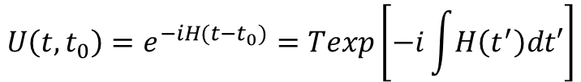
Time-dependence – Propagation methods
$$i\frac{∂}{∂t}ψ_{i}\left(r,t\right)=H_{ks}\left(t\right)ψ_{i}\left(r,t\right)⟹ψ\left(r,t\right)U\left(t,t_{0}\right)ψ_{i}\left(r, t_{0}\right)$$
$$U\left(t,t_{0}\right)=e^{−iH(t−t_{0})}=Texp\left[−i\int{H\left(t^{′}\right)dt′}\right]$$
Approximated enforced time reversal symmetry (aetrs)
Use time reversal symmetry to approximate Hamiltonian at the next time step
Update the time-evolved orbital wavefunction set
Cheap and efficient
Can lead to numerical divergences with nonlinear effects or long time steps
Crank-Nicholson
Time-centred implicit method
Unconditionally stable
Preserves unitarity
Expensive but accurate

Slide 16
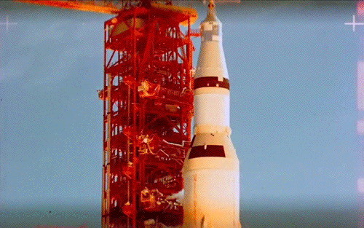

Why do a simulation?

Slide 17
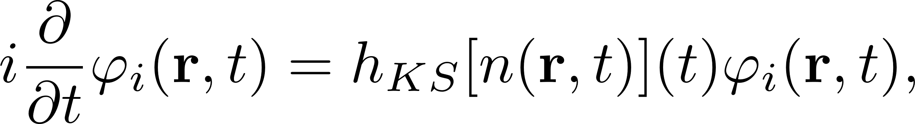
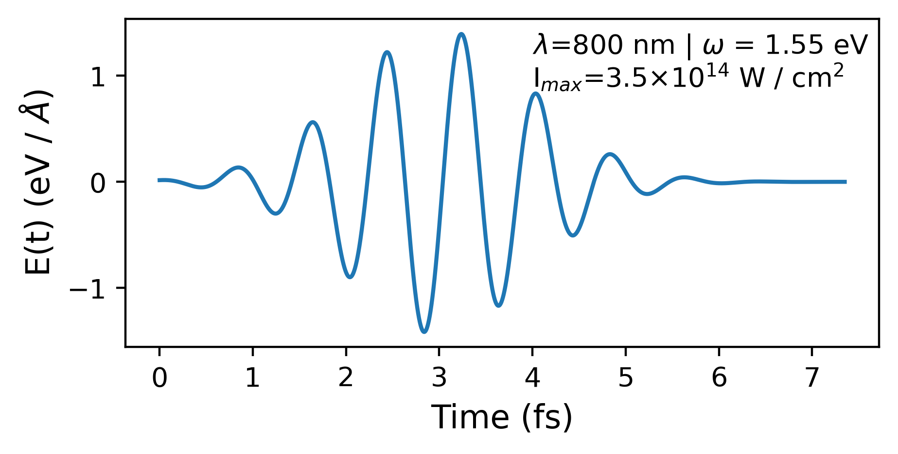


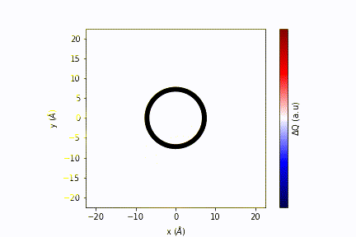
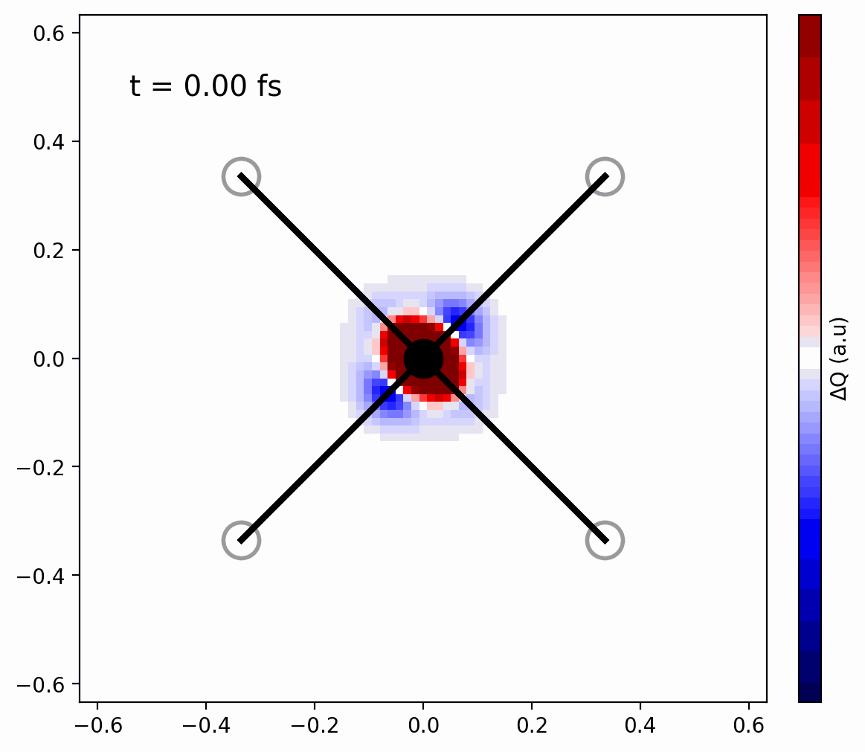
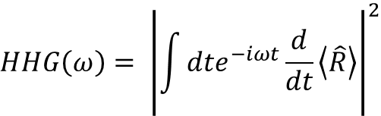
Responses
We may evolve the electronic system in time subject to some external potential.
Typically wanting to model some laser.
Calculate spectra from dipole evolution.
$$HHG\left(ω\right)= {\left|\int{dte^{−iωt}\frac{d}{dt}\left\langle \hat{R}\right\rangle }\right|}^{2}$$
ARPES
ECD
TA

Slide 18
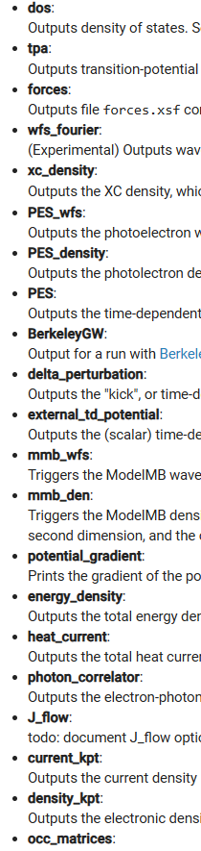
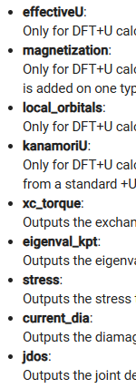
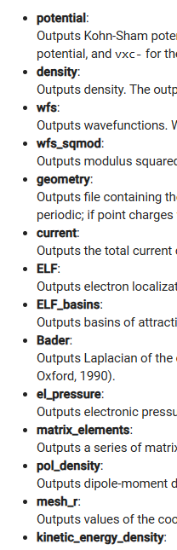
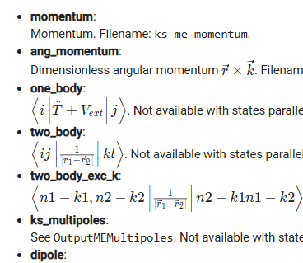
What can be calculated - static?

Slide 19
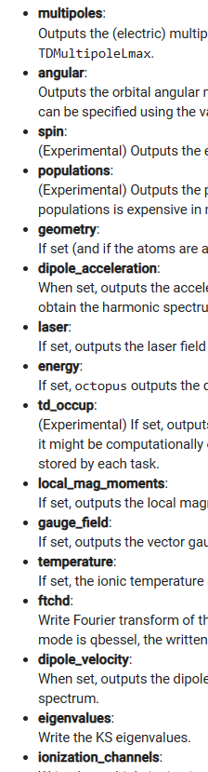
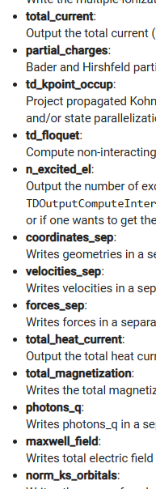
What can be calculated – time-dependent?

Slide 20
Time for some worked examples?
ARPES – Model Hydrogen chain
Optical response of molecules – Molecular nitrogen
HHG – 1d hydrogen
Ground state of a molecule – Methyloxirane
Bandstucture – BN
Transient Absorption – Model Hydrogen chain

